Slide 1
Introduction to SQL (for Querying databases) Paul Butler

Slide 2
Course Agenda
Introduction
Querying Data Using SQL
Where is the data?
CRUD – although we focus on the R part!
WHERE clause
OPERATORS
GROUP BY and Aggregations
UNIONS
DERIVED Table
DISTINCTS / COUNTS
JOINS
CASE STATEMENTS
IF / ELSE
STRING MANIPULATION
Quick intro to Data Types
VIEWS

Slide 3
INTRODUCTION

Slide 4
Introduction
This training is designed for those who wish to become more familiar with SQL and for those who wish to be able to self-serve when querying data from our SQL based databases – like DPAP BoutiqueDMS, BoutiquePrototype and BoutiqueSAFE:
BoutiqueDMS (Data Mart System) – contains latest released data marts for core verticals: Handset; PC; Tablet; Television; Lens; DSC and Action CAM; Petfood; Printer; Product Group DM; SDMA; and BfE Wireless Components – for some of these there are both monthly and weekly facts (Actuals) – these are updated for each release by Production Team
BoutiquePrototype – contains latest raw data for: Gaming Consoles; Gaming Software; PC Monitors; Navigation Devices; Optics; PC Accessories; PC and Tablet Peripherals; Printer Cartridges; Tires; Watches; Wearables; BfS Components – updated each month by Production Team
BoutiqueSAFE – will start to contain published forecasts – about to go live with Handset
The training mainly focuses on how we can query and retrieve data from a SQL database – it does not go into other aspects of the SQL language – like INSERTS, UPDATES and DELETES. It does not show how to create other T-SQL based components like Stored Procedures and User Defined Functions – this information will be available in a future more advanced training course. This training does not discuss database design or DDL / DCL Languages either
This training will be useful for any analyst who wants to know how to get the data they want out of SQL databases and at the same time manipulate what is returned to suit their specific reporting or analytical needs.

Slide 5
Querying DatA USING SQL

Slide 6
Querying Data Using SQL – BACKGROUND
STRUCTURED QUERY LANGUAGE
Sometimes pronounced as SEQUEL (Structured English QUEry Language)
Most database systems use the SQL Language for querying and manipulating the data stored in them
SQL has been around for a while now – I started using it over 20 years ago! But it was first created by IBM in the 70’s
Even today with more unstructured and bigger data – there are still tools written for NoSQL database systems like Hadoop that allow the querying of the data using the familiar SQL language – an example here would be Hive
Whether you use MS SQL Server or MySQL or DB2 or Oracle or Sybase or Ingres…..knowing basic SQL will come in extremely useful.
Before we look at the basics – we need to understand how data is stored in most SQL databases..

Slide 7
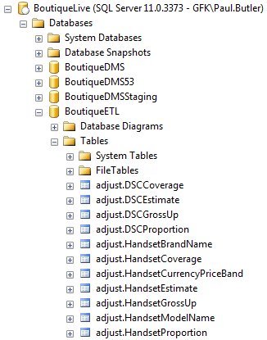
Querying Data Using SQL - Where is the data?
Where is the data stored:
SERVER
DATABASE
schema.TABLE – I’m in here!!!
Stored in rows and columns
ROWS are individual RECORDS
COLUMNS are individual FIELDS
(oh and Views too….)

Slide 8
Querying Data Using SQL - CRUD
CRUD is all you need
The 4 things you can do with data….
C – CREATE
R – READ
U – UPDATE
D – DELETE
How does this translate into the SQL Language?

Slide 9
Querying Data Using SQL - CRUD
CRUD is all you need
In SQL, CRUD can be expressed as one of the 4 main statements:
C – CREATE INSERT
R – READ SELECT – the FOCUS of this training!
U – UPDATE UPDATE
D – DELETE DELETE (or TRUNCATE)
These are the 4 key statements you can execute in SQL – if you are thinking there are more like “CREATE” / “ALTER” / “DROP” you are thinking DDL – and that’s another course – that will involve creating Stored Procedures and the likes!

Slide 10
Querying Data Using SQL - CRUD
So, SQL is quite straight forward as the statements you write are quite logical and are English-like statements
SELECT | INSERT | UPDATE | DELETE
SELECT this data | INSERT this data | UPDATE data in this table | DELETE this data
FROM this table | INTO this table | SET this field to this value | FROM this table
WHERE it meets these conditions | WHERE it meets these conditions | WHERE it meets these conditions | WHERE it meets these conditions
ORDER BY – return data in a certain order

Slide 11
Querying Data Using SQL – CRUD, the R Part! SELECT
SELECT Statement – this is how we read, search and look at the data stored in the database Tables or Views
-- Hello this is a useful comment!!
SELECT
*
FROM
[BoutiqueDMS].[handset].[dimHandsetBrand]
What does this do?
This will return ALL Rows and Columns in table dimHandsetBrand – which is located in the handset Schema in the BoutiqueDMS database

Slide 12

Querying Data Using SQL – WHERE clause
SELECT Statement – extending it a little with a WHERE clause and ORDER BY clause
SELECT
BrandName,
BrandGroupName
FROM
[BoutiqueDMS].[handset].[dimHandsetBrand]
WHERE
BrandName LIKE '%ppl%' -- this is a WILDCARD!
ORDER BY
BrandName DESC -- default is ASC (ascending)
This will return only fields (or columns) BrandName and BrandGroupName from table dimHandsetBrand.
It will only return records (or rows) where the brand name contains “ppl” – like Apple

Slide 13
Querying Data Using SQL
SELECT part – pretty straight forward, right!
I can specify the actual fields (aka columns) that I want to see
I can return all fields – by simply using the * asterix
Each field that I specify in the SELECT is separated with a comma (apart from the last one mentioned)
On top of this:
I can return the fields in any order that suits my needs – it doesn’t have to be the same order as found in the table:
I can return the field but give it my own name (using AS)
I can do a lot more on top of this too – but first let’s dig deeper with the WHERE clause…
SELECT
BrandGroupName,
BrandName
SELECT
BrandName,
BrandGroupName
SELECT
BrandGroupName AS [Brand Groups],
BrandName AS [Brands]

Slide 14
Querying Data Using SQL – WHERE Clause
The WHERE clause comes in useful in ALL SQL statements – SELECT / INSERT / UPDATE / DELETE
It allows you to be picky about the data you return in your query
It allows you to perform an action like update or delete on only certain records and not all table records
It allows you to search for records that meet certain search criteria
SELECT TOP 100 -- select the first 100 records meeting the criteria in the WHERE clause
ModelName,
DisplaySize,
DisplaySizeGrouping,
StorageCapacity,
BfEMajorModelGroupName,
ImageStabilization
FROM
[BoutiqueDMS].[handset].[dimHandsetModel]
WHERE
ModelName LIKE '%iphone%' -- return any model name that contains the characters 'iphone'
AND DisplaySize > 5 -- return only models that have a display size greater than 4
AND BfEMajorModelGroupName <> 'Unclassified' -- don't return models that have an 'unclassified' Major Model Group Name
AND StorageCapacity <= 128 -- return only models that have a storage capacity equal to or less than 128
AND (ImageStabilization = 'ELEC.STAB' OR ImageStabilization = 'BOTH') -- return models that either have 'ELEC.STAB' OR 'BOTH' image stabilization
Lynda.com link: Click Here

Slide 15
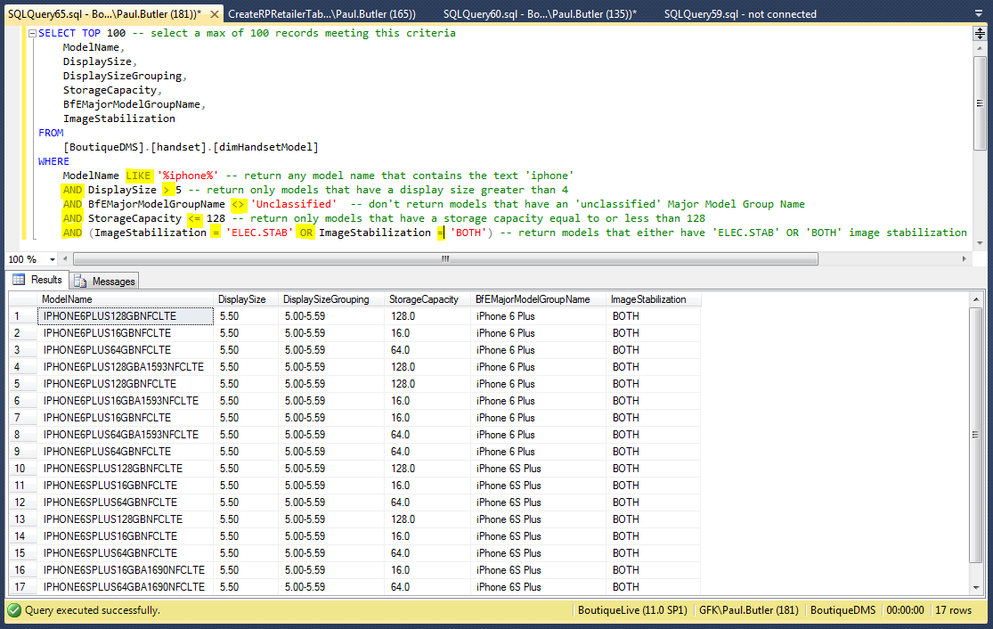
Querying Data Using SQL - OPERATORS
Those highlighted
bits are called
OPERATORS

Slide 16
Querying Data Using SQL - OPERATORS
What is an Operator in SQL?
An operator is a reserved word or a character used primarily in a SQL statement's WHERE clause to perform operation(s), such as comparisons and various arithmetic operations.
Types of operators…
Arithmetic operators
Comparison operators
Logical operators
Operators used to negate conditions

Slide 17
Querying Data Using SQL - OPERATORS
SQL Arithmetic Operators:
Assume variable a holds 10 and variable b holds 20, then:
Operator | Description | Example
+ | Addition - Adds values on either side of the operator | a + b will give 30
- | Subtraction - Subtracts right hand operand from left hand operand | a - b will give -10
* | Multiplication - Multiplies values on either side of the operator | a * b will give 200
/ | Division - Divides left hand operand by right hand operand | b / a will give 2
% | Modulus - Divides left hand operand by right hand operand and returns remainder | b % a will give 0

Slide 18
Querying Data Using SQL - OPERATORS
SQL Comparison Operators:
Assume variable a holds 10 and variable b holds 20, then:
Operator | Description | Example
= | Checks if the values of two operands are equal or not, if yes then condition becomes true. | (a = b) is not true.
!= | Checks if the values of two operands are equal or not, if values are not equal then condition becomes true. | (a != b) is true.
<> | Checks if the values of two operands are equal or not, if values are not equal then condition becomes true. | (a <> b) is true.
> | Checks if the value of left operand is greater than the value of right operand, if yes then condition becomes true. | (a > b) is not true.
< | Checks if the value of left operand is less than the value of right operand, if yes then condition becomes true. | (a < b) is true.
>= | Checks if the value of left operand is greater than or equal to the value of right operand, if yes then condition becomes true. | (a >= b) is not true.
<= | Checks if the value of left operand is less than or equal to the value of right operand, if yes then condition becomes true. | (a <= b) is true.
!< | Checks if the value of left operand is not less than the value of right operand, if yes then condition becomes true. | (a !< b) is false.
!> | Checks if the value of left operand is not greater than the value of right operand, if yes then condition becomes true. | (a !> b) is true.

Slide 19
Querying Data Using SQL - OPERATORS
SQL Logical Operators:
Operator | Description
ALL | The ALL operator is used to compare a value to all values in another value set.
AND | The AND operator allows the existence of multiple conditions in an SQL statement's WHERE clause.
ANY | The ANY operator is used to compare a value to any applicable value in the list according to the condition.
BETWEEN | The BETWEEN operator is used to search for values that are within a set of values, given the minimum value and the maximum value.
EXISTS | The EXISTS operator is used to search for the presence of a row in a specified table that meets certain criteria.
IN | The IN operator is used to compare a value to a list of literal values that have been specified.
LIKE | The LIKE operator is used to compare a value to similar values using wildcard operators.
NOT | The NOT operator reverses the meaning of the logical operator with which it is used. Eg: NOT EXISTS, NOT BETWEEN, NOT IN, etc. This is a negate operator.
OR | The OR operator is used to combine multiple conditions in an SQL statement's WHERE clause.
IS NULL | The NULL operator is used to compare a value with a NULL value.
UNIQUE | The UNIQUE operator searches every row of a specified table for uniqueness (no duplicates).

Slide 20
Querying Data Using SQL
Let’s use some more OPERATORS and start JOINING tables
/****** Show me all Apple Total Units and Values for Europe in Years 2014 to 2016 ******/
SELECT
FHM.[PeriodKey]
,DP.[YearNumber]
,DP.[MonthNumber]
,FHM.[CountryKey]
,DC.[CountryName]
,DC.[RegionName]
,'All Europe' AS [SuperRegion] -- I'm creating my own SuperRegion Field here..
,FHM.[ModelKey]
,FHM.[BrandKey]
,DHB.[BrandName]
,DHB.[BrandGroupName]
,FHM.[DigitalStandardKey]
,FHM.[DigitalStandardGroupKey]
,FHM.[OperatingSystemKey]
,FHM.[DataQualityKey]
,FHM.[WayOfBuying]
,FHM.[TotalUnitsSold]
,FHM.[TotalSubSalesValueBfE]
,FHM.[TotalUnsubSalesValueBfE]
,FHM.[AverageSellingPriceUSD]
,FHM.[ReleaseVersion]
FROM
[BoutiqueDMS].[handset].[factHandsetMonthly] FHM –- this is know as a Table ALIAS
LEFT JOIN [BoutiqueDMS].[handset].[dimHandsetBrand] DHB ON FHM.BrandKey = DHB.BrandId –- joining foreign key to primary key
LEFT JOIN [BoutiqueDMS].[shared].[dimPeriod] DP ON FHM.PeriodKey = DP.PeriodId –- joining foreign key to primary key
LEFT JOIN [BoutiqueDMS].[shared].[dimCountry] DC ON FHM.CountryKey = DC.CountryISO –- joining foreign key to primary key
WHERE
DP.YearNumber BETWEEN 2014 AND 2016 -- or could also write: DP.YearNumber IN (2014,2015,2016)
AND DHB.BrandGroupName = 'Apple' -- and where the brand group is Apple
AND DC.RegionName LIKE '%Europe%' -- and where the region name has Europe in it

Slide 21
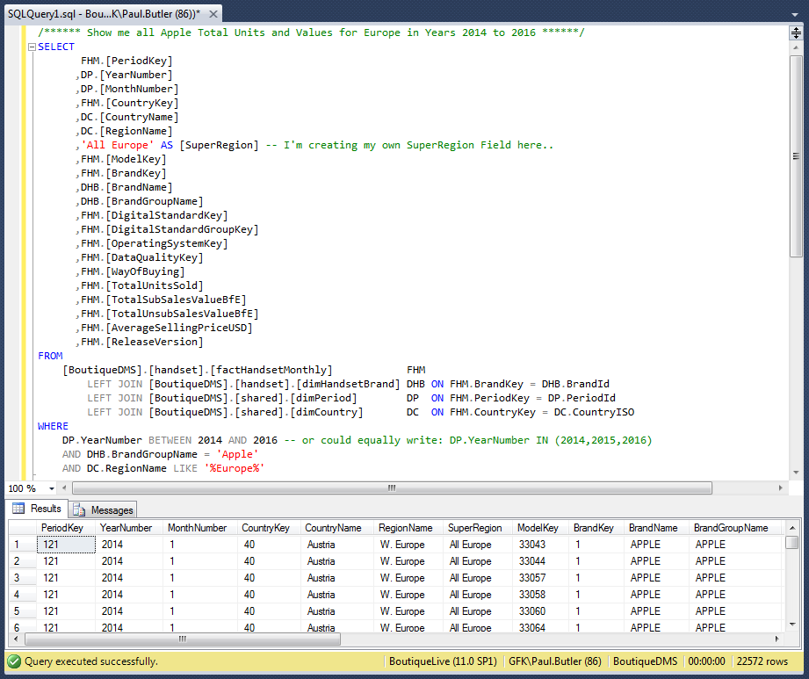
Querying Data Using SQL
I want to see all Apple European sales in Years 2014 to 2016 by Month..
This query is returning a lot of data – 22,572 rows – and it’s still far too granular to be useful – without putting it in XL and pivoting
I don’t really need to see countries, or individual regions
I don’t really need to see individual model Ids
So I’m going to remove these fields and start performing some aggregations in SQL
Also worth considering 3 other things I’ve done here:
Used Table ALIASES Lynda.com link
Joined Tables together using JOINS
Created my own field in the output
I’ve used the IN and BETWEEN operators

Slide 22
Querying Data Using SQL – GROUP BY
Let’s perform some Aggregations using GROUP BY - Lynda.com link
/****** Show me all Apple Total Units and Values for Europe in Years 2014 to 2016 ******/
SELECT
DP.[YearNumber]
,DP.[MonthNumber]
,'All Europe‘ AS [SuperRegion] -- I'm creating my own SuperRegion Field here..
,DHB.[BrandGroupName]
,SUM(FHM.[TotalUnitsSold]) AS [TotalEuropeUnitsSold]
,SUM(FHM.[TotalSubSalesValueBfE]) AS [TotalEuropeSubSalesValueBfE]
,SUM(FHM.[TotalUnsubSalesValueBfE]) AS [TotalEuropeUnsubSalesValueBfE]
,SUM(FHM.[TotalSubSalesValueBfE]) / SUM(FHM.[TotalUnitsSold]) AS [TotalEuropeAverageSellingPriceBfE]
FROM
[BoutiqueDMS].[handset].[factHandsetMonthly] FHM
LEFT JOIN [BoutiqueDMS].[handset].[dimHandsetBrand] DHB ON FHM.BrandKey = DHB.BrandId
LEFT JOIN [BoutiqueDMS].[shared].[dimPeriod] DP ON FHM.PeriodKey = DP.PeriodId
LEFT JOIN [BoutiqueDMS].[shared].[dimCountry] DC ON FHM.CountryKey = DC.CountryISO
WHERE
DC.RegionName LIKE '%Europe%'
GROUP BY
DP.[YearNumber],
DP.[MonthNumber],
DHB.[BrandGroupName]
HAVING
DP.YearNumber IN (2014,2015,2016)
AND DHB.BrandGroupName = 'Apple'
ORDER BY
YearNumber,
MonthNumber
This is starting to get a little advanced now! But we are still only scraping the surface of what SQL can do…
I’m performing SUM aggregations and introducing the GROUP BY clause (which allows for aggregations) and for fields that I aggregate on that were previously in the WHERE clause – these have now moved to the HAVING clause. Basically HAVING is the WHERE for GROUP BY statements!

Slide 23
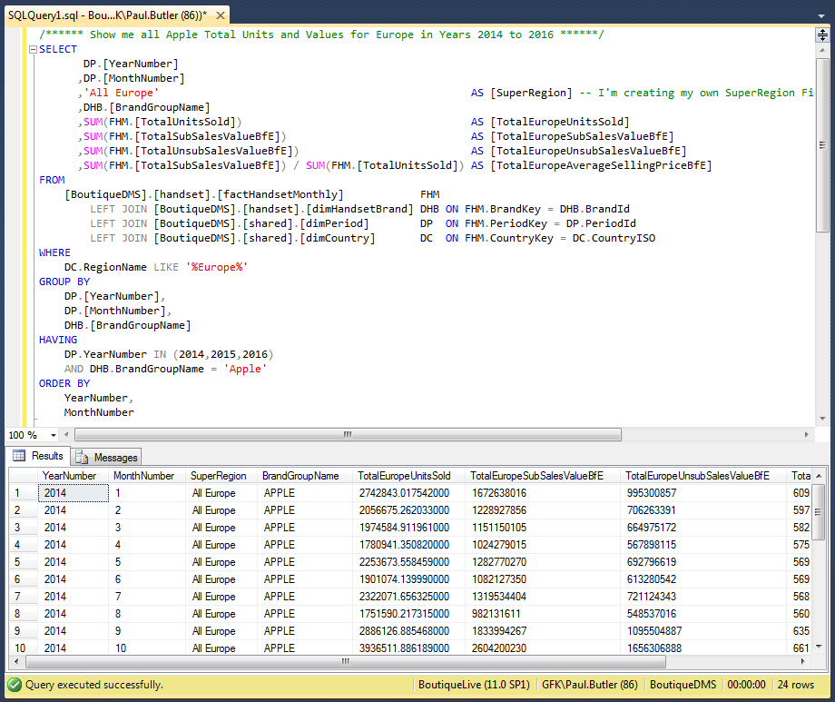
Querying Data Using SQL – GROUP BY
I want to see all Apple European sales in Years 2014 to 2016 by Month..
So from 22,572 rows I now have 24 rows – giving me the aggregated amounts that I’m after. To achieve this, I’ve used the:
GROUP BY clause
HAVING clause
SUM – to add the grouped records – there are other similar functions like COUNT, MIN, MAX, AVG, etc.
I’ve given the calculated fields names
I’ve used the / division arithmetic operator to calculate the ASP
These facts are only related to Handsets – I want to bring in Tablet sales too – and these sales are stored in a completely different set of tables in BoutiqueDMS – so for this I need to use UNIONs to join output from 2 queries together

Slide 24
Querying Data Using SQL - UNIONS
/****** Show me all Apple Total Units and Values for Europe in Years 2014 to 2016 ******/
SELECT
DP.[YearNumber]
,DP.[MonthNumber]
,'All Europe' AS [SuperRegion] -- I'm creating my own SuperRegion Field here..
,DHB.[BrandGroupName]
,'HANDSET' AS [VerticalName] -- I've added a new field to specify each vertical
,SUM(FHM.[TotalUnitsSold]) AS [TotalEuropeUnitsSold]
,SUM(FHM.[TotalSubSalesValueBfE]) AS [TotalEuropeSubSalesValueBfE]
,SUM(FHM.[TotalUnsubSalesValueBfE]) AS [TotalEuropeUnsubSalesValueBfE]
,SUM(FHM.[TotalSubSalesValueBfE]) / SUM(FHM.[TotalUnitsSold]) AS [TotalEuropeAverageSellingPriceBfE]
FROM
[BoutiqueDMS].[handset].[factHandsetMonthly]FHM
LEFT JOIN [BoutiqueDMS].[handset].[dimHandsetBrand] DHB ON FHM.BrandKey = DHB.BrandId
LEFT JOIN [BoutiqueDMS].[shared].[dimPeriod] DP ON FHM.PeriodKey = DP.PeriodId
LEFT JOIN [BoutiqueDMS].[shared].[dimCountry] DC ON FHM.CountryKey = DC.CountryISO
WHERE
DC.RegionName LIKE '%Europe%'
GROUP BY
DP.[YearNumber],
DP.[MonthNumber],
DHB.[BrandGroupName]
HAVING
DP.YearNumber IN (2014,2015,2016)
AND DHB.BrandGroupName = 'Apple'
UNION ALL
SELECT
DP.[YearNumber]
,DP.[MonthNumber]
,'All Europe' AS [SuperRegion] -- I'm creating my own SuperRegion Field here..
,UPPER(DTB.[BrandGroupName]) AS [BrandGroupName]
,'TABLET' AS VerticalName -- I've added a new field to specify each vertical
,SUM(FTM.[TotalUnitsSold]) AS [TotalEuropeUnitsSold]
,SUM(FTM.[TotalSalesValueEUR]) AS [TotalEuropeSubSalesValueBfE]
,SUM(FTM.[TotalSalesValueNSEEUR]) AS [TotalEuropeUnsubSalesValueBfE]
,SUM(FTM.[TotalSalesValueEUR]) / SUM(FTM.[TotalUnitsSold]) AS [TotalEuropeAverageSellingPriceBfE]
FROM
[BoutiqueDMS].[tablet].[factTabletMonthly]FTM
LEFT JOIN [BoutiqueDMS].[tablet].[dimTabletBrand] DTB ON FTM.BrandKey = DTB.BrandId
LEFT JOIN [BoutiqueDMS].[shared].[dimPeriod] DP ON FTM.PeriodKey = DP.PeriodId
LEFT JOIN [BoutiqueDMS].[shared].[dimCountry] DC ON FTM.CountryKey = DC.CountryISO
WHERE
DC.RegionName LIKE '%Europe%'
GROUP BY
DP.[YearNumber],
DP.[MonthNumber],
DTB.[BrandGroupName]
HAVING
DP.YearNumber IN (2014,2015,2016)
AND DTB.BrandGroupName = 'Apple'
ORDER BY
YearNumber,
MonthNumber,
VerticalName
Things to know about UNIONS:
Interestingly, UNIONs are really quite fussy..
The data sets you union together should match – e.g.
same number of fields and same data types
If you want to order the returned data in the UNION,
the order by clause can only be specified right at the
end – however doing this can also slow down performance!
You can UNION more than 2 queries – as shown in this
example
There are 2 types of UNION:
UNION – if there are duplicate records returned in
each select then these dupes will be removed – so
only distinct (unique) records are returned
UNION ALL – all records are returned including any
duplicates
So let’s perform a UNION!

Slide 25
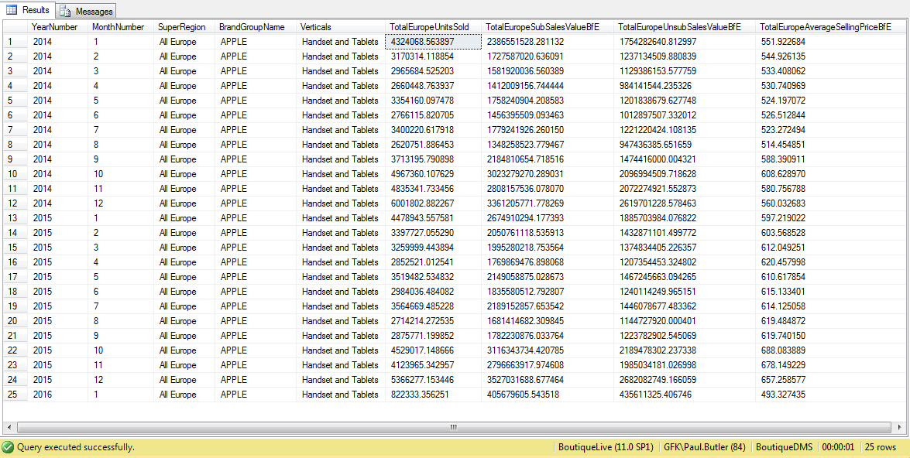
Querying Data Using SQL – DERIVED Table
/****** Show me all Apple Total Units and Values for Europe in Years 2014 to 2016 for both Handsets and Tablets ******/
SELECT
[YearNumber] ,
[MonthNumber],
[SuperRegion],
[BrandGroupName],
'Handset and Tablets' AS Verticals,
SUM([TotalEuropeUnitsSold]) AS [TotalEuropeUnitsSold],
SUM([TotalEuropeSubSalesValueBfE]) AS [TotalEuropeSubSalesValueBfE],
SUM([TotalEuropeUnsubSalesValueBfE]) AS [TotalEuropeUnsubSalesValueBfE],
SUM([TotalEuropeSubSalesValueBfE]) / SUM([TotalEuropeUnitsSold]) AS [TotalEuropeAverageSellingPriceBfE]
FROM
(
SELECT
DP.[YearNumber]
,DP.[MonthNumber]
,'All Europe' AS [SuperRegion] -- I'm creating my own SuperRegion Field here..
,DHB.[BrandGroupName]
,'HANDSET' AS [VerticalName] -- I've added a new field to specify each vertical
,SUM(FHM.[TotalUnitsSold]) AS [TotalEuropeUnitsSold]
,SUM(FHM.[TotalSubSalesValueBfE]) AS [TotalEuropeSubSalesValueBfE]
,SUM(FHM.[TotalUnsubSalesValueBfE]) AS [TotalEuropeUnsubSalesValueBfE]
,SUM(FHM.[TotalSubSalesValueBfE]) / SUM(FHM.[TotalUnitsSold]) AS [TotalEuropeAverageSellingPriceBfE]
FROM
[BoutiqueDMS].[handset].[factHandsetMonthly]FHM
LEFT JOIN [BoutiqueDMS].[handset].[dimHandsetBrand] DHB ON FHM.BrandKey = DHB.BrandId
LEFT JOIN [BoutiqueDMS].[shared].[dimPeriod] DP ON FHM.PeriodKey = DP.PeriodId
LEFT JOIN [BoutiqueDMS].[shared].[dimCountry] DC ON FHM.CountryKey = DC.CountryISO
WHERE
DC.RegionName LIKE '%Europe%'
GROUP BY
DP.[YearNumber],
DP.[MonthNumber],
DHB.[BrandGroupName]
HAVING
DP.YearNumber IN (2014,2015,2016)
AND DHB.BrandGroupName = 'Apple'
UNION ALL
SELECT
DP.[YearNumber]
,DP.[MonthNumber]
,'All Europe' AS [SuperRegion] -- I'm creating my own SuperRegion Field here..
,UPPER(DTB.[BrandGroupName]) AS [BrandGroupName]
,'TABLET' AS VerticalName -- I've added a new field to specify each vertical
,SUM(FTM.[TotalUnitsSold]) AS [TotalEuropeUnitsSold]
,SUM(FTM.[TotalSalesValueEUR]) AS [TotalEuropeSubSalesValueBfE]
,SUM(FTM.[TotalSalesValueNSEEUR]) AS [TotalEuropeUnsubSalesValueBfE]
,SUM(FTM.[TotalSalesValueEUR]) / SUM(FTM.[TotalUnitsSold]) AS [TotalEuropeAverageSellingPriceBfE]
FROM
[BoutiqueDMS].[tablet].[factTabletMonthly]FTM
LEFT JOIN [BoutiqueDMS].[tablet].[dimTabletBrand] DTB ON FTM.BrandKey = DTB.BrandId
LEFT JOIN [BoutiqueDMS].[shared].[dimPeriod] DP ON FTM.PeriodKey = DP.PeriodId
LEFT JOIN [BoutiqueDMS].[shared].[dimCountry] DC ON FTM.CountryKey = DC.CountryISO
WHERE
DC.RegionName LIKE '%Europe%'
GROUP BY
DP.[YearNumber],
DP.[MonthNumber],
DTB.[BrandGroupName]
HAVING
DP.YearNumber IN (2014,2015,2016)
AND DTB.BrandGroupName = 'Apple'
) AS DERIVEDTABLE -- Using a derived table here
GROUP BY
DERIVEDTABLE.[YearNumber],
DERIVEDTABLE.[MonthNumber],
DERIVEDTABLE.[BrandGroupName],
DERIVEDTABLE.[SuperRegion]
ORDER BY
DERIVEDTABLE.[YearNumber],
DERIVEDTABLE.[MonthNumber]
The previous UNION returns separate records for both handsets and tablets. I’ve therefore
introduced another concept here:
Using a DERIVED table – I essentially treat the UNIONed data as a single table and then
select and aggregate from this “derived” table….
This now allows me to output handset and tablet data as one complete dataset as shown:
SQL can be pretty quick – in under 1 second – this query has trawled through all 1 million
Tablet facts and 6 million Handset facts and aggregated the data as requested. Of course
badly written SQL can perform very slowly too..

Slide 26
Querying Data Using SQL – DISTINCT / COUNT
Actually how do I quickly find out how many records I’m dealing with?
Here we simply use the COUNT function – as shown here..
SELECT COUNT(*) FROM [BoutiqueDMS].[tablet].[factTabletMonthly] -- returns 1,041,975
SELECT COUNT(*) FROM [BoutiqueDMS].[handset].[factHandsetMonthly] -- returns 6,081,115
You can find out how many countries we have facts for in the last period that are in the fact table – here I’m introducing the DISTINCT (see Lynda.com: Click Here) and MAX functions – the MAX function is in a Subquery (see Lynda.com: Click Here )
SELECT DISTINCT -- introducing DISTINCT
CountryKey
FROM
[BoutiqueDMS].[tablet].[factTabletMonthly]
WHERE
PeriodKey = (SELECT MAX(PeriodKey) FROM [BoutiqueDMS].[tablet].[factTabletMonthly]) -- introducing using result of SELECT in WHERE clause and MAX too
We could check how many fact records we have for each country in the last period too
SELECT DISTINCT -- introducing DISTINCT
CountryKey,
COUNT(CountryKey) NumberOfCountryFactsForLastPeriod
FROM
[BoutiqueDMS].[tablet].[factTabletMonthly]
WHERE
PeriodKey = (SELECT MAX(PeriodKey) FROM [BoutiqueDMS].[tablet].[factTabletMonthly]) -- introducing using result of SELECT in WHERE clause and MAX too
GROUP BY
CountryKey

Slide 27
Querying Data Using SQL - JOINS
JOINS - what JOINS are available in SQL?
You use joins when you need to return data from more than one table – i.e. returning a name from a primary table rather than an “Foreign Key” Id in a fact table – as Ids don’t really mean that much to an end user or client!
What are Primary Keys and Foreign Keys? Check out Lynda.com - Click Here – this talks about Normalization (basically organising your data)
There are many types of join – that can greatly impact on what data is returned to the end user:
INNER - i.e. middle of Venn, there is at least one match in both the tables
OUTER - LEFT, RIGHT and FULL – more on these in next slide
CROSS JOIN - return all rows from the left table. Each row from the left table is combined with all rows from the right table. Cross joins are also called Cartesian products.
Joins can be specified in either the FROM or WHERE clauses; specifying them in the FROM clause is recommended and the normal approach. WHERE and HAVING clauses can also contain search conditions to further filter the rows selected by the join conditions.

Slide 28
Querying Data Using SQL - JOINS
JOINS - what JOINS are available in SQL?
LEFT JOIN or LEFT OUTER JOIN
The result set of a left outer join includes all the rows from the left table specified in the LEFT OUTER clause, not just the ones in which the joined columns match. When a row in the left table has no matching rows in the right table, the associated result set row contains null values for all select list columns coming from the right table.
RIGHT JOIN or RIGHT OUTER JOIN
A right outer join is the reverse of a left outer join. All rows from the right table are returned. Null values are returned for the left table any time a right table row has no matching row in the left table.
FULL JOIN or FULL OUTER JOIN
A full outer join returns all rows in both the left and right tables. Any time a row has no match in the other table, the select list columns from the other table contain null values. When there is a match between the tables, the entire result set row contains data values from the base tables.
More info can be found here from Microsoft: Microsoft Link Or Lynda.com: Lynda.com Link

Slide 29

Querying Data Using SQL - JOINS

Slide 30
Querying Data Using SQL – CASE STATEMENTS
CASE STATEMENTS
These are very useful – as you can to test for certain values in a field and output an alternative value based on your requirements.
A simple example below is where I’m looking for Apple and Samsung Brands and outputting a value that I need for a certain report – all other brands can be output as “OTHERS” (see the optional ELSE statement at the end):
SELECT
BrandName,
CASE BrandName
WHEN 'Apple' THEN 'APPLE INC'
WHEN 'Samsung' THEN 'SAMSUNG ELECTRONICS'
ELSE 'OTHERS'
END AS [TopBrands]
FROM
[handset].[dimHandsetBrand]
ORDER BY
TopBrands
Case statements are very useful for calculating/outputting fields like “pricebands” – note that once a condition is met the statement exits:
SELECT TOP(100)
AverageSellingPriceEUR,
CASE
WHEN AverageSellingPriceEUR < 0 THEN '<0'
WHEN AverageSellingPriceEUR <= 50 THEN '0-50'
WHEN AverageSellingPriceEUR <= 100 THEN '50-100'
WHEN AverageSellingPriceEUR <= 150 THEN '100-150'
WHEN AverageSellingPriceEUR <= 200 THEN '150-200'
WHEN AverageSellingPriceEUR <= 400 THEN '200-400'
WHEN AverageSellingPriceEUR <= 600 THEN '400-600'
ELSE '600+'
END AS PriceBandEUR
FROM
[handset].[factHandsetMonthly]
More useful info can be found here at Microsoft: Microsoft Link Or Lynda: Lynda.com Link

Slide 31
Querying Data Using SQL – IF / ELSE
IF and ELSE STATEMENTS
It is possible to write T-SQL (Transact SQL) that imposes conditions on what is executed based on specific values of variables. This really is something you come across much more in the world of Stored Procedures – but the concept can still be used in standard T-SQL queries too.
First you would declare some variables to store values that you want to test in your IF statement – and based on these values decide what happens next – here is a quick simple example:
-- Declare a variable
DECLARE @monthName varchar(10)
-- Set Default value for variable
SET @monthName = 'JANUARY'
-- Set the variable value to latest month found in Handset Fact table
SELECT @monthName = [MonthName] FROM shared.dimPeriod WHERE PeriodId IN (SELECT MAX(PeriodKey) FROM handset.factHandsetMonthly)
-- If the latest month is DECEMBER then perform the action between the BEGIN and END control-of-flow keywords
IF @monthName = 'DECEMBER'
BEGIN
SELECT
@monthName + ' is the last month of the year!' AS [Message],
(SELECT [YearNumber] FROM shared.dimPeriod WHERE PeriodId IN (SELECT MAX(PeriodKey) FROM handset.factHandsetMonthly)) AS [Year]
END
ELSE -- If not December then do this instead
BEGIN
SELECT @monthName + ' is not the last month of the year!' AS [Message]
END
More help on this at Microsoft – IF….ELSE (Click Here) and focus on ELSE (Click Here)

Slide 32
Querying Data Using SQL – STRING MANIPULATION
There is a lot you can do in SQL on manipulating data before it gets returned to the end user
Here are some things I do a lot with regards to what I call STRING Manipulation – saves mucking about in XL with dodgy transitions and unnecessary formulas and worksheets!
Concatenation – see Lynda.com example (Click Here)
LEN – the length of a string
LEFT / RIGHT– start looking at the left or right side or middle of a string
UPPER / LOWER – make upper or lower case
LTRIM / RTRIM – remove unwanted empty spaces in the string (at the beginning / end / both)
REVERSE – change the order of string
FORMAT – lot’s of format options to make the returned data look nicer! Often used with Dates
SUBSTRING – grab part of a string
REPLACE – replace all or part of a string
CHARINDEX – useful for finding an expression within a string and return starting position if found
SOUNDEX – does the string sound like…. (not covered today)
Here Microsoft describe all key string functions: Click Here OR Lynda.com: Click Here

Slide 33
Querying Data Using SQL – STRING MANIPULATION
Concatenation Example:
SELECT
BusinessHashKeyExample1,
BusinessHashKeyExample2,
BusinessHashKeyExample3,
-- Test that one is same as two
CASE
-- notice when I write a string with a single quote I need to put 2 quotes there
WHEN BusinessHashKeyExample1 != BusinessHashKeyExample2 THEN 'They Don''t Match'
ELSE'Yeah - They Match!'
END AS Test1and2Match,
-- Test if two is the same as three
CASE
WHEN BusinessHashKeyExample2 != BusinessHashKeyExample3 THEN 'They Don''t Match'
ELSE'Yeah - They Match!'
END AS Test2and3Match
FROM
(
SELECT DISTINCT TOP (100)
HB.BrandName,
HM.ModelName,
HDS.DigitalStandardName,
CONCAT(HB.BrandName,HM.ModelName,HDS.DigitalStandardName)AS BusinessHashKeyExample1, -- one method of concatenation
HB.BrandName + HM.ModelName + HDS.DigitalStandardNameAS BusinessHashKeyExample2, -- another method of concatenation
-- The one below - I need to convert ModelKey (which is an INT) to VarChar - to be able to concatenate to a string
HB.BrandName + '/' + HM.ModelName + '/' + HDS.DigitalStandardName + ': ' + CAST(FHM.ModelKey AS Varchar(10)) AS BusinessHashKeyExample3
FROM
[handset].[factHandsetMonthly] FHM -- inner join from fact table to Model / Brand / DS dimension tables using PK and FKs
INNER JOIN [handset].[dimHandsetModel] HM ON FHM.ModelKey = HM.ModelId -- Inner Joins are SAFE here
INNER JOIN [handset].[dimHandsetBrand] HB ON FHM.BrandKey = HB.BrandId
INNER JOIN [handset].[dimHandsetDigitalStandard] HDS ON FHM.DigitalStandardKey = HDS.DigitalStandardId
) AS ConcatenationExample -- A Derived Table

Slide 34
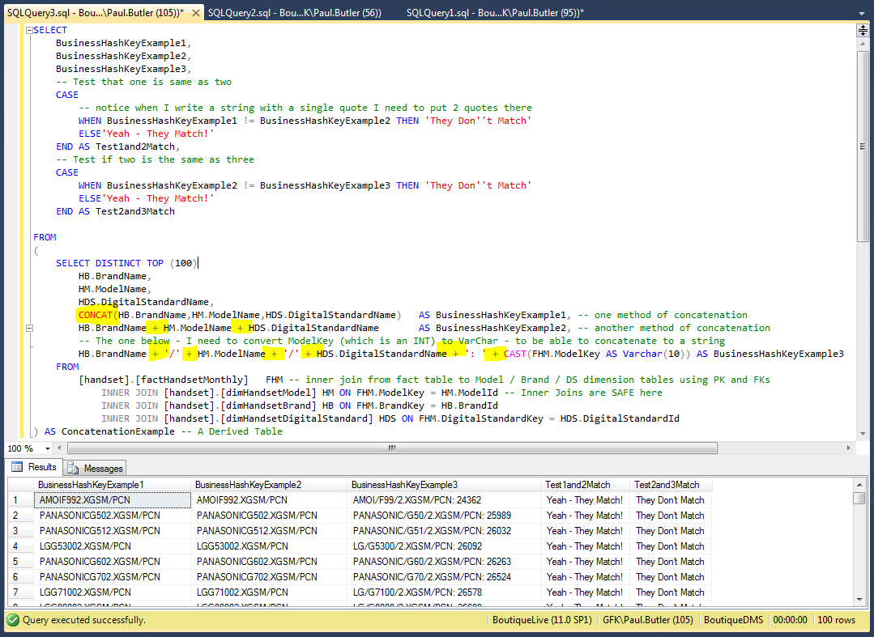
Querying Data Using SQL – STRING MANIPULATION
The query is overly complex to reintroduce some previously discussed functions..
The are 2 ways to concenate – both are highlighted here.
However, we have also used:
CASE Statements
DERIVED table
INNER JOINS
And introducing a CAST and concept of data types!!
How to output text with single quote

Slide 35
Querying Data Using SQL – STRING MANIPULATION
Examples of LEN / LEFT / RIGHT / TRIM / REVERSE / LOWER / REPLACE / SUBSTRING
SELECT
BusinessHashKeyExample1,
--BusinessHashKeyExample2, -- comment out - doesn't mean I still can't use it in STRING or other functions
BusinessHashKeyExample3,
LEN(BusinessHashKeyExample1) AS HashKey1Length, -- Return length of string
LEN(BusinessHashKeyExample3) AS HashKey3Length, -- Return length of string - includes leading spaces
LEFT(BusinessHashKeyExample1,3) AS LeftKey1Chars, -- Return first x number of chars in string - here 3
RIGHT(BusinessHashKeyExample1,5) AS RightKey1Chars, -- Return last x number of chars in string - here 5
REVERSE (RIGHT(BusinessHashKeyExample1,5)) AS ReverseRightKey1Chars, -- Reverse string - but perform on another string function
LTRIM(BusinessHashKeyExample3) AS TrimmedKey3, -- Remove the leading spaces - i.e. to the LEFT
LOWER(BusinessHashKeyExample2) AS LowerCaseKey2, -- Use LOWER to Lower Case and UPPER to do the opposite!
REPLACE(LOWER(BusinessHashKeyExample2),'/','') AS RemoveBackSlash, -- Replace one char with something else
SUBSTRING(LTRIM(BusinessHashKeyExample3),LEN(LTRIM(BusinessHashKeyExample3))-4,5) AS ModelKey, -- SUBSTRING (expression , start , length)
CHARINDEX(':',BusinessHashKeyExample3,0) AS ColonPosition -- Return first occurence of colon in the string
FROM
(
SELECT DISTINCT TOP (100)
HB.BrandName,
HM.ModelName,
HDS.DigitalStandardName,
CONCAT(HB.BrandName,HM.ModelName,HDS.DigitalStandardName)AS BusinessHashKeyExample1, -- one method of concatenation
HB.BrandName + HM.ModelName + HDS.DigitalStandardNameAS BusinessHashKeyExample2, -- another method of concatenation
-- The one below - I need to convert ModelKey (which is an INT) to VarChar - to be able to concatenate to a string
' ' + HB.BrandName + '/' + HM.ModelName + '/' + HDS.DigitalStandardName + ': ' + CAST(FHM.ModelKey AS Varchar(10))
AS BusinessHashKeyExample3
FROM
[handset].[factHandsetMonthly] FHM -- inner join from fact table to Model / Brand / DS dimension tables using PK and FKs
INNER JOIN [handset].[dimHandsetModel] HM ON FHM.ModelKey = HM.ModelId -- Inner Joins are SAFE here
INNER JOIN [handset].[dimHandsetBrand] HB ON FHM.BrandKey = HB.BrandId
INNER JOIN [handset].[dimHandsetDigitalStandard] HDS ON FHM.DigitalStandardKey = HDS.DigitalStandardId
) AS ConcatenationExample -- A Derived Table

Slide 36
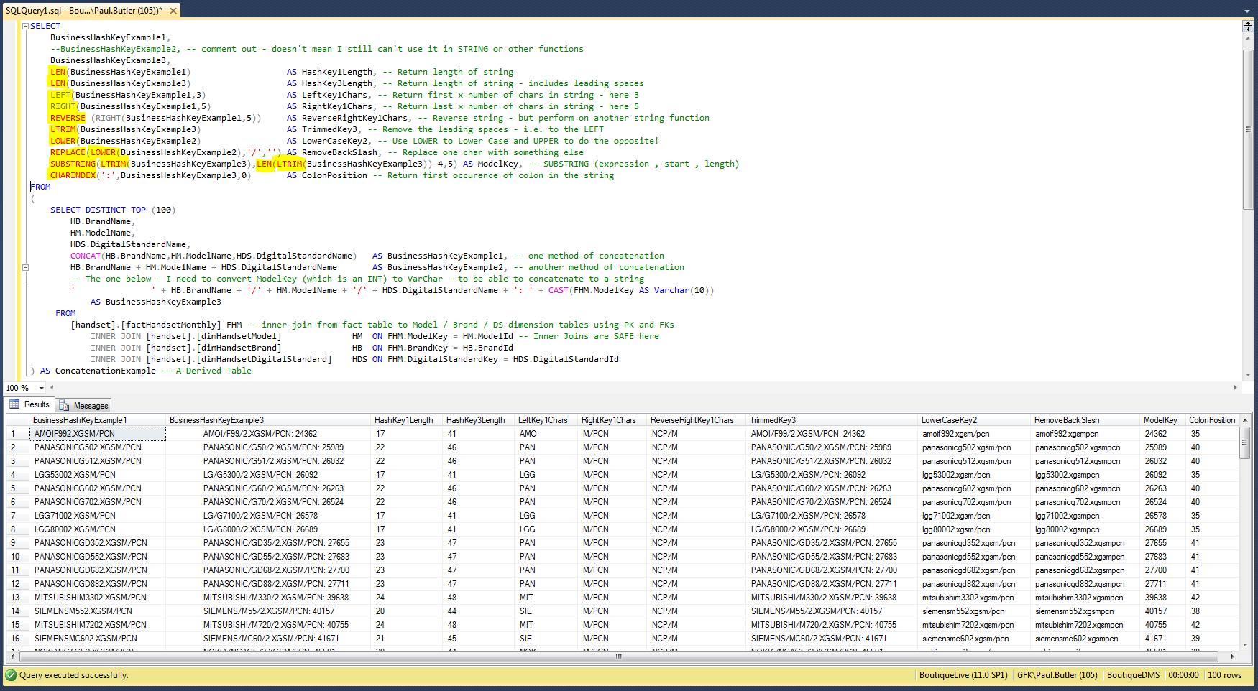
Querying Data Using SQL – STRING MANIPULATION

Slide 37
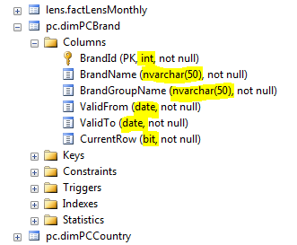
Querying Data Using SQL – DATA TYPES
It’s really important to understand the different data types in SQL
Data Types – really are about storing the data as efficiently as possible and also about helping SQL to understand what sort of data is contained in each table’s field
When you look at a table in SSMS (SQL Server Management Studio 2012 – get it installed!) – you can clearly see the data types for each field:
You need to understand what data types you are working with
because:
Trying to perform a string based function on a number may cause an error
Trying to perform a date/time based expression on a string may cause an error
Trying to perform an arithmetic calculation on a text/date field – is just not going to happen
You get the message!
Fortunately, SQL offers many ways to convert (or cast) text to numbers/dates and numbers to text –
allowing you to perform the actions you need to perform even if the source data isn’t always stored as
the correct or preferred data type that would allow this from the outset.
More info at Microsoft here: Click Here

Slide 38
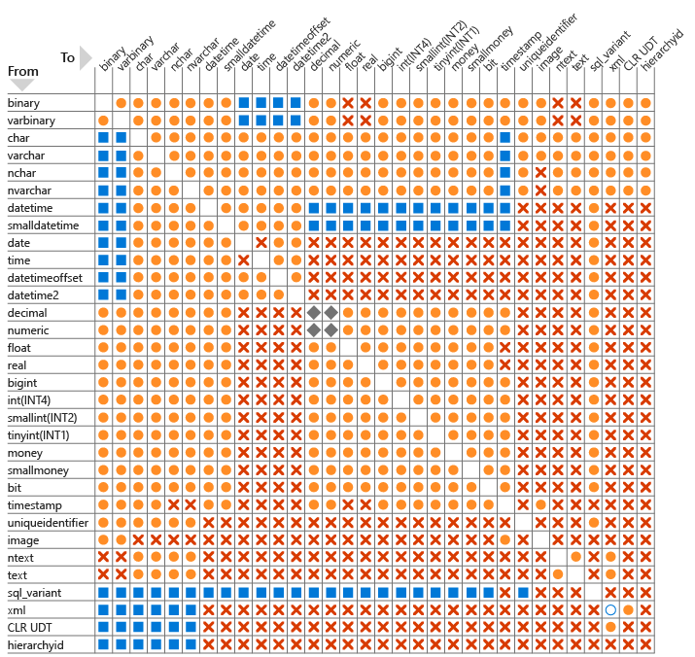
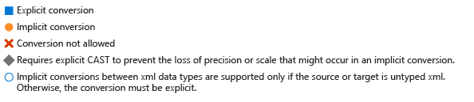
Querying Data Using SQL – DATA TYPES
You use functions CONVERT or CAST to change data types in SQL – syntax as below:
CAST ( expression AS data_type [ ( length ) ] )
CONVERT ( data_type [ ( length ) ] , expression [ , style ] )
This is quite a complex and big topic – especially when dealing with dates – a very important aspect in querying data - so I recommend listening to the Lynda.com video on this: Click here to watch
Correct use of data types can also help boost query performance!

Slide 39
Querying Data Using SQL - VIEWS
OK – so you’ve spent a lot of time creating the perfect query in SQL – a query that you now actually want to reuse each release for a specific XL report or client dashboard..
In this situation I’d recommend creating a View..
A View is stored in the database and behaves a bit like a Table – but is based off a SQL query with the result being stored ready to access in rows and columns as if it were a table. SQL will also try to optimise the query by precompiling certain aspects of it – so sometimes you will also get performance benefits. However a badly written query will be slow whether it is executed as a View or a regular SQL query!
Sometimes if your SQL gets too big and convoluted – with Derived Tables, UNIONS and so on – it may be simpler to create smaller Views and then join and extend these together rather than trying to do everything in one massive piece of SQL!
At the moment we only really allow BI Dev Team and Production to create views – so please note you may need to ask the BI Team to deploy a View that you create to the production server – as you will probably not have permissions to create the View directly on the Server. If you do have permission the View may suddenly disappear – as it would not have been added to our code repository and a future deployment will therefore remove it!
Getting the BI Team / Production to add your View into our code repository is a good thing - as it will also be checked against our coding standards (another training course is available on this!) – and be properly version controlled and maintained…

Slide 40
Querying Data Using SQL - VIEWS
Views are Very simple to Create – here’s a simple example:
CREATE VIEW [handset].[E2SDimHandsetBrandView]
AS
SELECT
BR.BrandId,
BR.BrandName,
ISNULL(AN.NewBrandName,BR.BrandName) AS BrandReportName,
CAST(BG.BrandGroupName AS NVARCHAR(50)) AS BrandGroupName,
BR.TransactionId
FROM
[handset].[HandsetBrand] BR (NOLOCK)
LEFT JOIN [handset].[HandsetBrandGroup](NOLOCK) BG ON BR.BrandGroupKey = BG.BrandGroupId
LEFT JOIN [adjust].[HandsetBrandName](NOLOCK) AN ON BR.BrandName = AN.OldBrandName
GO
It’s literally just adding the CREATE VIEW ….. AS part at the beginning – followed by your SQL Query!
Here is a video on creating Views in SQL Server – using the rather simple tool that creates SQL for you! Granted we prefer to create Views using pure SQL like above with Joins – rather than this tool – but it’s still a useful video
Click Here to Watch

Slide 41
Querying Data Using SQL
There is an awful lot to learn – and I’ll therefore recommend doing the whole of this Lynda Course:
http://www.lynda.com/SQL-Server-tutorials/Querying-Microsoft-SQL-Server-2012/156769-2.html
I also plan to do more advanced SQL courses later this year, specifically on:
Creating STORED PROCS / UDFS / Triggers
Dynamic SQL
Pivoting Data
More focus on INSERTS / UPDATES / DELETES….
Database Design – OTLP / OLAP
Understanding Execution Plan and Trace options
DBA stuff and Maintenance Plans
In the meantime there is more advanced SQL courses on Lynda too - SQL Server: Triggers, Stored Procedures, and Functions: Click here to view
THANKS FOR YOUR ATTENDANCE!!!

